Slide 1
May 2017
Full Stack Developer - PA Skilling Program Design

Slide 2


Full Stack Developer – PA Skilling Program design
Objective & Outcome
To skill PA associate in minimum FSD skills to make them a Junior developer who can later be trained in other adjust skills to become FSD
PA’s are equipped to be trained for other FSD skills

Slide 3
Design Approach
Pre-Assessment
Learning by Action Learning Project (ALP)
Exit Assessment
Daily Code Gym
Identify associate current skill level and form groups based on their competency levels to plan for the training sessions and fast tracking high performers
Develop project with minimum FSD skills which will enable associates to upskill adjacent skills in the respective technology areas
Practice coding daily in problem solving model to get fluency in programming and scripting languages
Performance from Action Learning Project will be considered
Integrated Assessment (Multi skill assessment, for individuals) and HackerRank/Codility assessment
Work as a team and collaborate, associate must work on various skills at different point of time

Slide 4
High Level Timeline
Week0 | Week1 | Week2 | Week3 | Week4 | Week5 | Week6 | Week7
Pre-Assessment | SDLC Methodologies & S/W platforms |  |  |  |  | Refresh sessions | Integrated Assessment & HackerRank/ Codility Assessment
 | Language & Layers
 | Ancillary capabilities | Ancillary Capabilities | Ancillary capabilities
 |  |  | Architecture Patterns & Infra Platforms
Learning sessions windows are just guideline for Trainer to cover various skill areas in alignment with the ALP
ALP development start
ALP Evaluation
ALP rework and completed

Slide 5
Day Plan
Daily Code Gym
Associate to use HackerRank community to practice Language and Layer skills (~1hr daily)
Daily Review
Previous day recap and project status review by Trainer (~1hr)
Training Session
Trainer conducting sessions on the selected topics and guiding associates to undergo e-learning (1 to 2 hrs)
Action Learning Project
Associates to work on the action learning project development most of the time in a day
GitLab (code.cognizant.com) is proposed as code repository and for collaboration. BFS VM Lab for project development (TBC)

Slide 6
Action Learning Project (teams of 3)
Action Learning Project case study is given to a group of associates. Each group will have 3 associates.
Each associate will work on a requirement or module in one of the technology area in a week, and take up another module in the subsequent week after and so on, thereby exposing all the team members to the various skills, and encouraging collaboration.
Every week one associate will take the Module lead role and also oversee the code integration/merge
Gitlab (code.cognizant.com) to be used for code repository and collaboration.
 | UI/Frontend Development | Server side/Backend development | Integration/ Database | Module Lead/ Code integrator
Requirement/ Module1 | Associate1 | Associate2 | Associate3 | Associate1
Requirement/ Module2 | Associate2 | Associate3 | Associate1 | Associate2
Requirement/ Module3 | Associate3 | Associate1 | Associate2 | Associate3
Week1
Week2
Week3

Slide 7
PA Skill Trajectory and Enablement list
PA Skill Trajectory from BU, the minimum skills to be considered for this batch is highlighted in Green
List of enablement’s identified for the listed skills – To be reviewed by BU SMEs
Novice and Advanced Beginners are mapped to PL1 and Competent to PL2 to align with CCA

Slide 8
PA Skill Trajectory for Assessment Scope
 | Languages | Layers | Ancillary Capabilities | SDLC Methodologies | Software Platforms | Architecture Patterns | Infrastructure Platforms
Action Learning Project and Integrated Skill Assessment | HTML | Angular 2.0 | Maven | Test Driven Development | Tomcat | Server or Client side MVC
 | XML | JSP / Servlet | GIT | Coding best practices
 | JSON | Spring MVC | GitHub
 | SQL | Jersey | Junit
 | Java | JAX-RS | PMD/CheckStyle/ FindBugs
 | JavaScript | JPA
 |  | Hibernate
 |  | Oracle
MCQ Assessment (To be included only if required) |  |  |  |  | Platform Concepts | MVC | PaaS/AWS

Slide 9
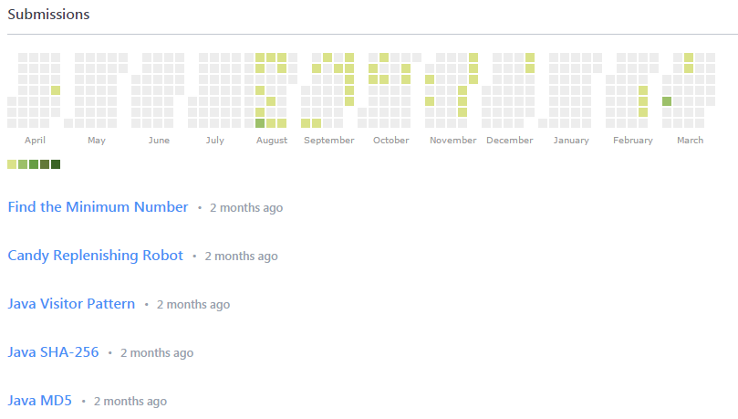
HackerRank Community
Associate can register in https://www.hackerrank.com with their personal email
https://www.hackerrank.com/dashboard will provide practice platform for various technology areas
As part of the Daily Code Gym activity Associate must practice various coding problems daily for ~1hr
Associate submissions will be available in Hackerrank profile as below

Slide 10
Exit Assessments
Integrated Assessment covers the SDLC cycle - Coding, Unit Testing and Build/Deployment
Problem statement would be solvable by multiple skills from the skill cluster
Assessment planned for 8 hr. for developing the end to end program based on the problem statement provided.
HackerRank or Codility Assessment will focus mainly on the algorithmic and problem solving using data structures and logic implementation
The assessment will be for 2-3hrs with 5-6 coding questions

Slide 12
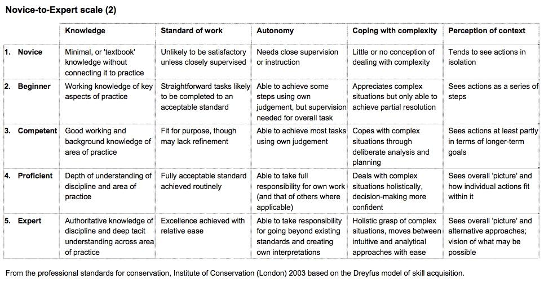
Skill acquisition model – Dreyfus model Vs CCA Proficiency
Learner - PL1
Practitioner - PL2
Specialist - PL3
Expert – PL4

Slide 13
Skill acquisition model – CCA USF defined by Mercer
Definition Type | Learner – PL1 | Practitioner – PL2 | Specialist – PL3 | Expert – PL4
Refined Definition (based on Bloom's Taxonomy) | Level of Proficiency: - Remembering - Understanding - Applying (initial) | Level of Proficiency: - Applying (higher order) - Analyzing (initial) | Level of Proficiency: - Analyzing (higher order) - Evaluating (initial) - Creating (initial) | Level of Proficiency: - Evaluating (higher order) - Creating (higher order)
Common Definition of Applicability (across categories) | Expectations: - Convert pseudo-code to code - Develop basic programs as per design/algorithms provided - Follow coding standards to develop simple components - Follow and apply instructions for code documentation/comments, deployment and all coding practices | Expectations - Create pseudo-code based on design - Develop advanced programs or modules as per design/algorithm - Follow coding standards to develop modules/layers, and complex or group of components - Refine development, UI and query guidelines for efficiency | Expectations - Analyze and identify technical risks and failure points, and define mitigation strategies during coding - Evaluate code for maintainability and other non-functional aspects - Analyze, evaluate and recommend appropriate framework, approach, solution, library and tool/product to meet the functional and non functional requirements - Compare and contrast technology landscape options for the customer - Create POC to validate on new frameworks, components, models, tools and solutions | Expectations - Create, identify, evaluate and recommend frameworks, approaches, solutions, libraries and tools/ accelerators based on the technology - Create framework / accelerators/ component repository or library for optimal solution development - Create/customize development framework or platforms for team to streamline effort - Evaluate new version of products (beta version) , any new products in the market - Set up labs using the newer technology - Provide thought leadership (seminars, while papers, IP etc.) and mentor the team to build the necessary capabilities

